Slide 1

Making the Case for CAES (Compressed Air Energy Storage) & Electric Vehicles
Roydon A. Fraser
Department of Mechanical and Mechatronics
Taiyuan Energy Low Carbon Development Forum 2016
Sept 7-9, 2016

Slide 2
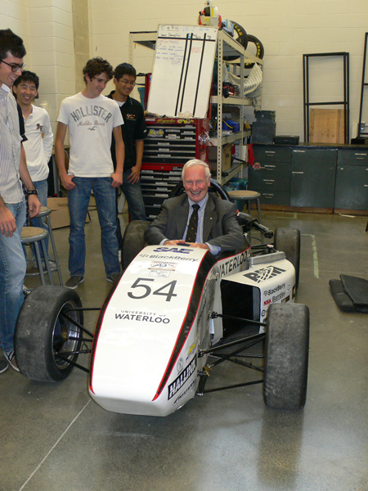

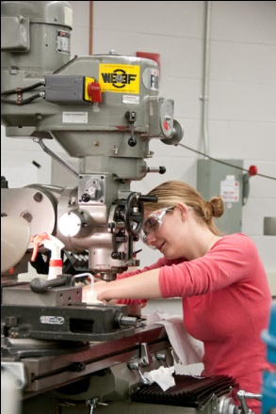
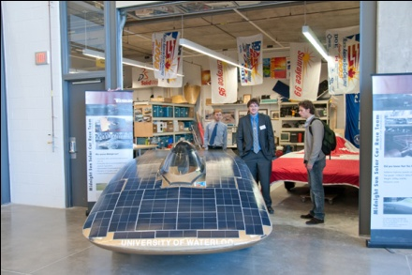
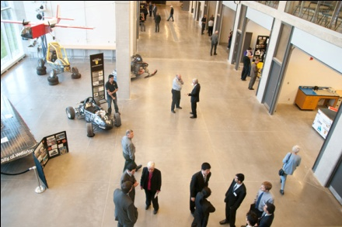
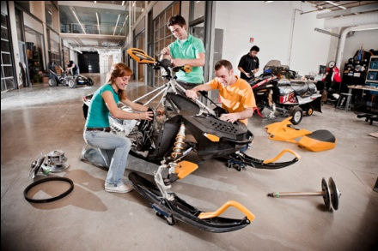
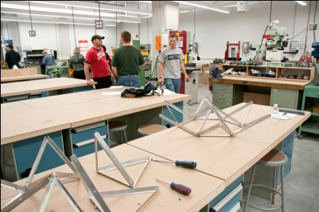
The future…

Slide 3
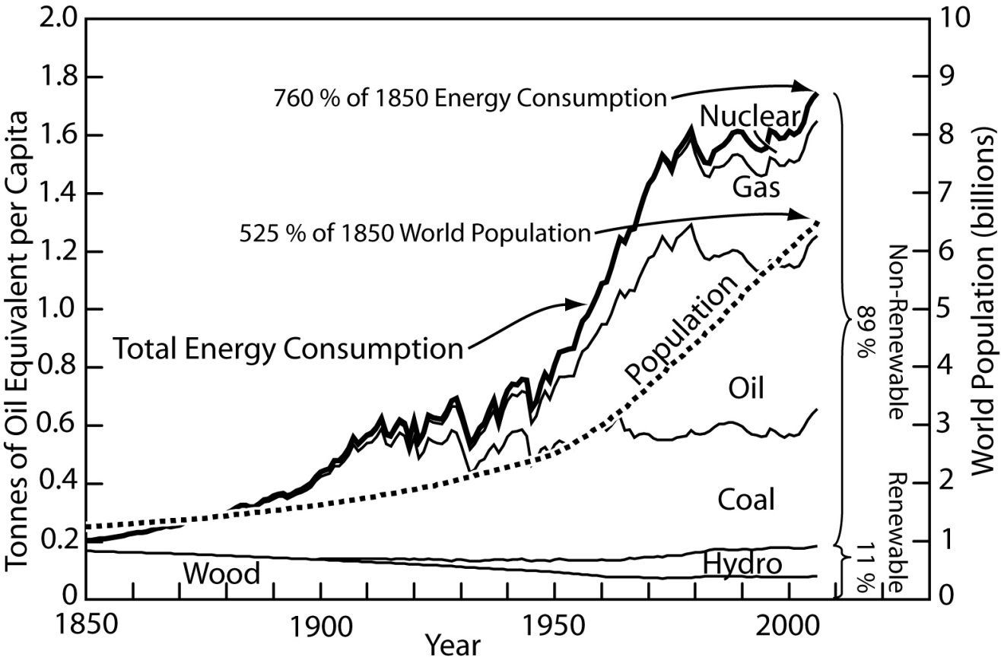
Energy Situation:
Dominated by Carbon

Slide 4
Some Common Proposed
Carbon Reduction Solutions
Carbon capture & sequestration (CCS)
Coal-to-gas
Shift to natural gas
Increase nuclear
Increase efficiency
Substitute with renewables

Slide 5
Some Common Proposed
Carbon Reduction Solutions
Carbon capture & sequestration (CCS)
Coal-to-gas
Shift to natural gas
Increase nuclear
Increase efficiency
Substitute with renewables
For large scale impact:
Must convert Wind / Solar
Electricity
BUT, intermittency Maximum Electricity
Grid Integration Limited

Slide 6
What Limits Wind & Solar?
Intermittency / Electricity Grid Stability
Jevon’s Paradox

Slide 7
What Limits Wind & Solar?
Example:
Per capita energy
consumption
remains constant.
Intermittency / Electricity Grid Stability
Jevon’s Paradox

Slide 8
Jevon’s Paradox
(or Energy Efficiency Paradox)
Examples:
1. Car engine efficiency up
car size up
fuel economy (mpg) 2000 < 1980
2. Cell phone efficiency up
screen size & computational power up
electrical power up
Expect if more access to energy will still access

Slide 9
Solution to Grid Stability for Renewables
Large scale (> 500 MWh) energy storage.
Solution to
Jevon’s Paradox
Make paradigm shifting changes.

Slide 10
Solution to Grid Stability for Renewables
Large scale (> 500 MWh) energy storage.
Example: Compressed Air Energy Storage (CAES)
Solution to
Jevon’s Paradox
Make paradigm shifting changes.
CAES is not a battery, it is a hybrid vehicle.
Notes:
Can be both a ‘source’ and a ‘load’. Sell electricity each hour, and absorb over 5 to 15 minute periods.

Slide 11


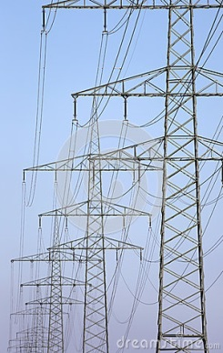
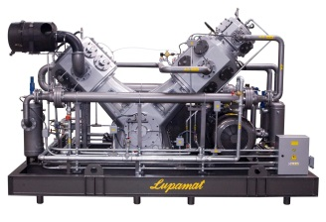
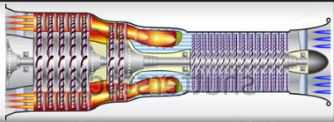
The CAES Concept…
sun→power
wind→power
grid
Heat storage
turbine
CA
CA
CA storage
Salt gallery

Slide 12
Canada: GHG emissions by sector
Non-combustible
6.3%
Commercial 5.2%
Other 11.4%
Transportation
31.5%
Industrial
16.3%
Power generation
20.4%
Residential
8.9%

Slide 13
Canada: GHG emissions by sector
Non-combustible
6.3%
Commercial 5.2%
Other 11.4%
Transportation
31.5%
Industrial
16.3%
Power generation
20.4%
Residential
8.9%
CAES
more renewables

Slide 14
Canada: GHG emissions by sector
Non-combustible
6.3%
Commercial 5.2%
Other 11.4%
Transportation
31.5%
CAES
more renewables
through EVs
(a paradigm shift)
Industrial
16.3%
Power generation
20.4%
Residential
8.9%
CAES
more renewables

Slide 15
Canada: GHG emissions by sector
Non-combustible
6.3%
Commercial 5.2%
Other 11.4%
Transportation
31.5%
CAES
more renewables
through EVs
(a paradigm shift)
Industrial
16.3%
CAES
more renewables
through EVs
(second use)
Power generation
20.4%
Residential
8.9%
CAES
more renewables

Slide 16
Alternatives to CAES
Pumped Hydro
Location limited.
Batteries
Toxic Expensive
Flywheels
Large Size Unproven
Chemical
Large Size Safety

Slide 17
Alternatives to CAES
Pumped Hydro
Location limited.
Batteries
Toxic Expensive
Flywheels
Large Size Unproven
Chemical
Large Size Safety
Slow
Fast
Fast
Transportable

Slide 18
CAES is not new, so why now?
Horizontal drilling advances,
from Fracking.
Electricity grid stability hitting
wind and solar limits.

Slide 19
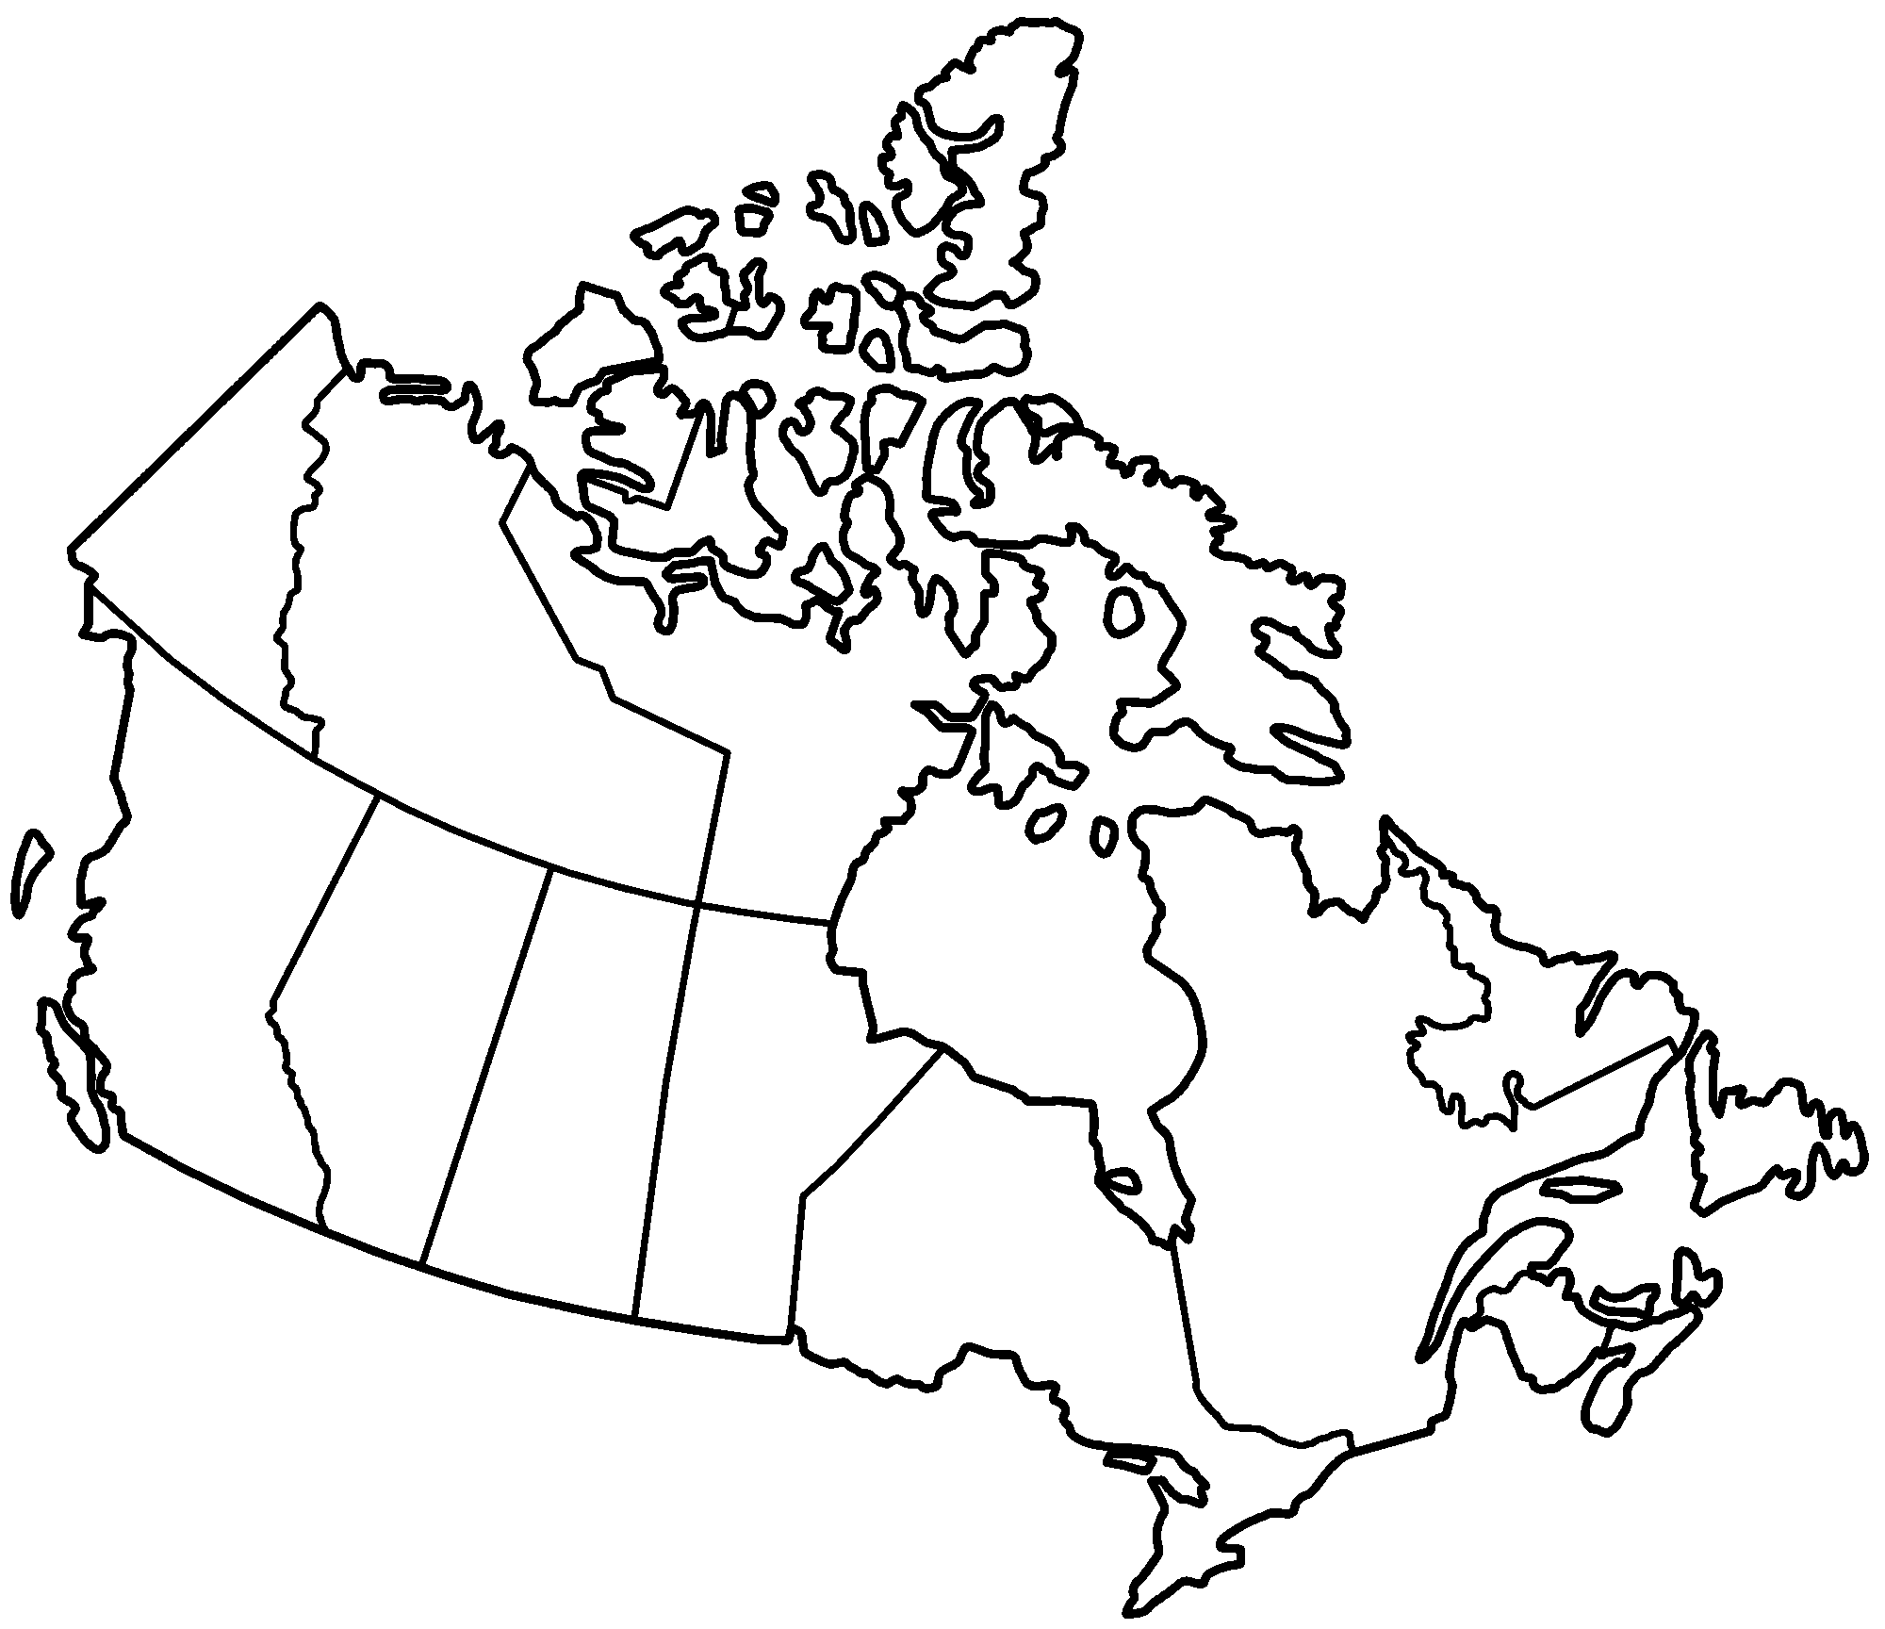
Salt for CAES, South of 60°
AB
AB
SK
MB
QC
ON
NB & NS

Slide 20
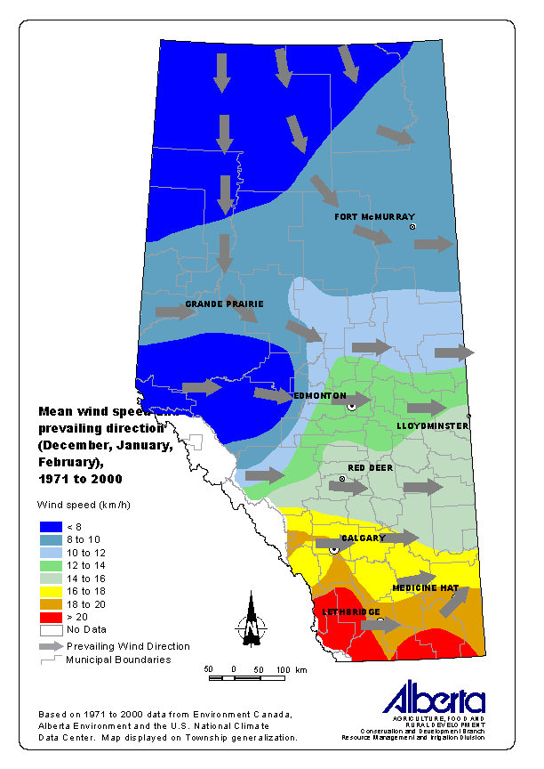
Cold Lake Fm
Prairie Evaporite
Lotsberg Salt
Cold Lake Fm
1000 – 2200 m deep. Up to 200 m thick. Ideal for CAES caverns
Wind in Dec
Superposed with Salt Strata

Slide 21
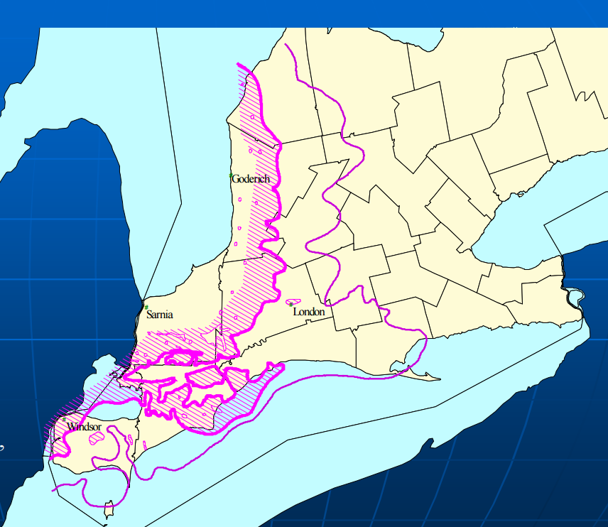
Thick Salt & Good Wind!
Lake Huron Coast = best windy sites in
SW ON
Bruce
Toronto
Salina B Salt – thickest, but not the deepest

Slide 22
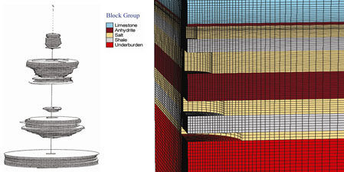
Bedded Salt Cavern Simulation
Reality Quarter-World Model

Slide 23
CAES - Constant P Mode
tubings
casing
top of salt
roof salt
shoe
rathole
free air
volume
height
spacing
BRINE
500 - 2000 m
floor salt
width

Slide 24
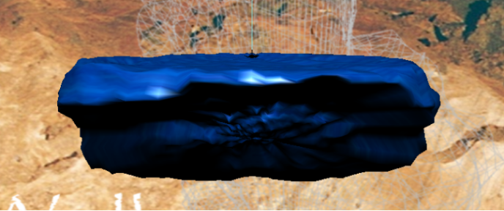
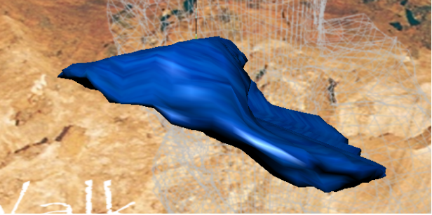
A Problem
Large pancake salt caverns have an inherent problem: Limited size or collapse.
Pancake Salt Cavern
Collapsed Cavern

Slide 25
Gallery Stress Redistribution
Laminated EP Roof Rock
Redistribution of stresses
σ_{θ}
Stress trajectories
σ_{θ}
σ_{r}
20-40 m
30-40 m
p_{i}
σ_{r}
Salt creeps!
30 year life, up to 10,000 Δp cycles?

Slide 26
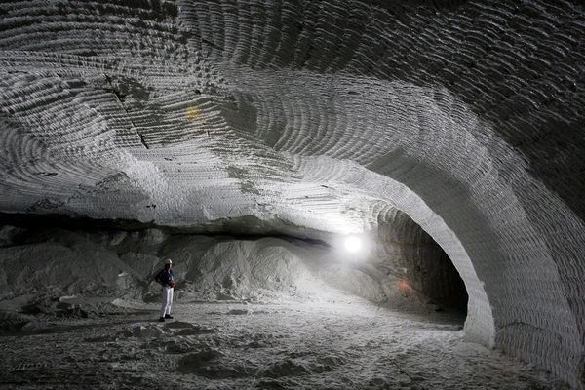
Salt - Asse Salt Mine (DE)
In thinly bedded salt (<100 m), long galleries needed to achieve sufficient Volume for CAES
Courtesy National Geographic

Slide 27
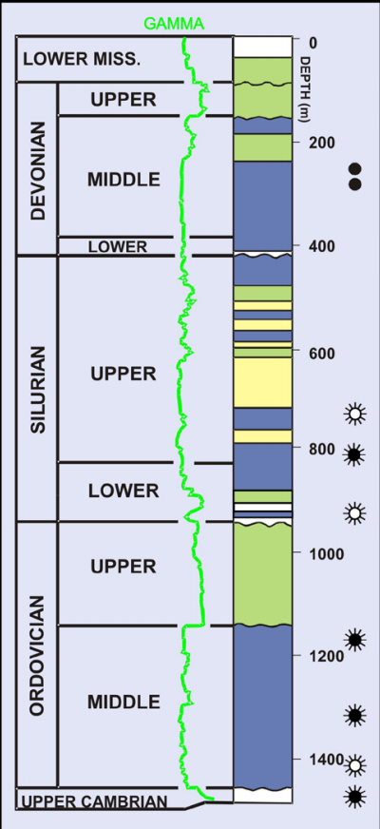
In Our Study… AB & ON
The thinly bedded salts of ON will require the use of long Galleries for economies of scale
The solutioning of such cigar shaped galleries is novel
400-700 m deep
1 km

Slide 28
Geomechanics…
Long (800 m) galleries in thinly bedded salt is a new idea

Slide 29
Geomechanics…
Long (800 m) galleries in thinly bedded salt is a new idea
Stability issues
  Long-term roof span stability in non-salt rocks
  Cyclic loading and permeability/gas effects
  Modeling rock mass behavior is needed

Slide 30
Geomechanics…
Long (800 m) galleries in thinly bedded salt is a new idea
Stability issues
  Long-term roof span stability in non-salt rocks
  Cyclic loading and permeability/gas effects
  Modeling rock mass behavior is needed
A new advantage for long galleries…
  Roof stable for larger cavern

Slide 31
What Is Feasible?
In Ontario’s bedded salts…?
  galleries – 25 m diameter – 800-1000 m long (cigar)
  300-500x10³ m³ volumetric capacity per gallery
  500 m deep to perhaps 750 m deep
What pressure ranges?
  For 500 m: ~3.5 to ~9 MPa Δp
  For 750 m: ~5 to ~14 MPa Δp
In Alberta?
  Axisymmetric (pancake) caverns, 300-500x10³ m³
  1200-1500 m deep: ~8 to ~25 MPa Δp

Slide 32
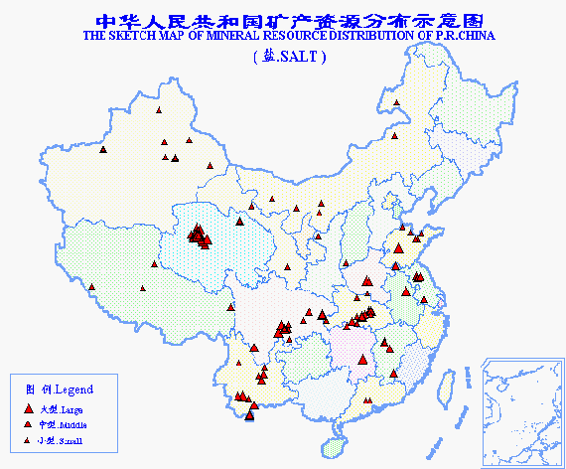

Slide 33
Natural Gas Storage?
Power-to-Gas?

Slide 34
CAES Discipline Integration
Earth Science & Geomechanics
Grid Information
Geoscience Parameters
Geoscience Parameters
PVT Issues
Power Engineering
Grid Information
Mechanical Engineering
Generation inputs, parameters

Slide 35
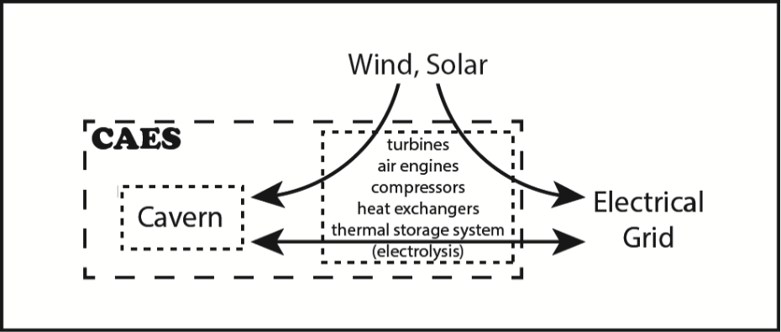
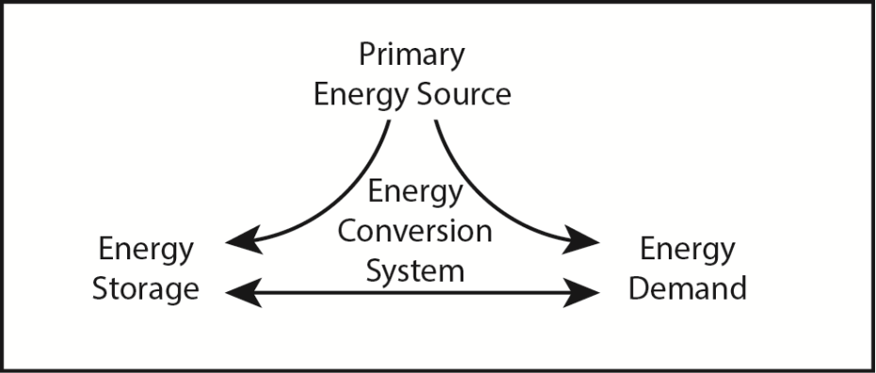
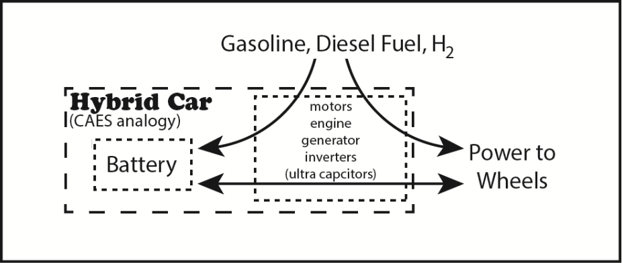
CAES / Hybrid Car Analogy
Analogy leverages extensive hybrid vehicle expertise in
1. Model-based design rapid
prototyping
2. Specification identification
3. Architecture selection &
sizing
4. Integration
5. Control
6. Optimization
7. Implementation &
validation

Slide 36
CAES / Hybrid Car Analogy
Analogy leverages extensive hybrid vehicle expertise in
1. Model-based design rapid
prototyping **
2. Specification identification **
3. Architecture selection &
sizing **
4. Integration ##
5. Control ##
6. Optimization
7. Implementation &
validation ##
** NSERC CRD over next 2 years
## Sarnia based pilot for consideration

Slide 37
Design of Hybrid Cars is Driven by Drive Cycles
Gasoline
Only
Series
Hybrid
Parallel
Hybrid

Slide 38
Design of Hybrid Cars is Driven by Drive Cycles
Gasoline
Only
Series
Hybrid
Parallel
Hybrid
FAST
SLOW
FAST
SLOW

Slide 39
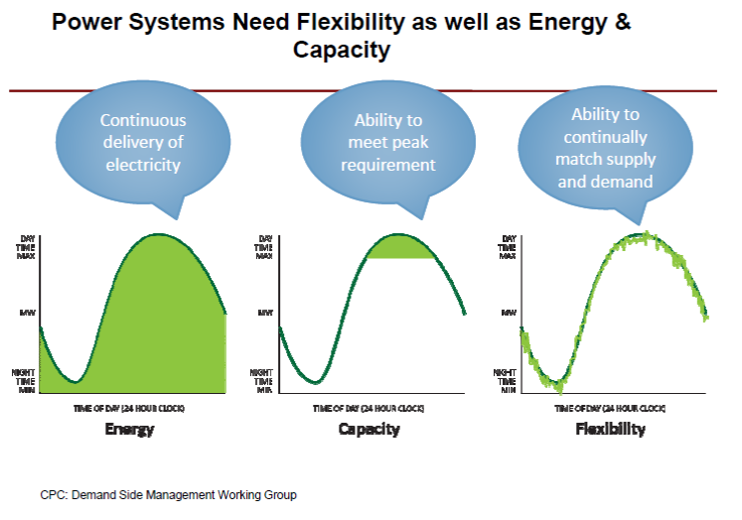
The CAES Drive Cycle

Slide 40
The CAES Drive Cycle
SLOW
FAST

Slide 41
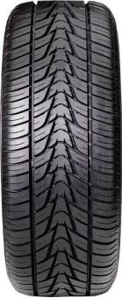
UWAFT Vehicle Powertrain - Split
A Hybrid Vehicle Architecture
Front
Component Description | Performance Specifications
Engine: Weber MPE 850cc Turbo | Peak Power | 92 kW
Transmission: GM 8L45 AT | Number of Gears | 8
 | Type | Long. Auto
Final Drive: GM 3.73 Final Drive, eLSD | Final Drive Ratio | 3.73 : 1
Motors: GKN AF 130-4 | Peak Power at 292V | 90 kW
 | Cont. Power at 292V | 64 kW
Battery: A123 6x15s3p | Capacity | 16.2 kWh
 | Nominal Voltage | 292 V
 | Peak Current | 400 A
Charger: Brusa NLG513 | Peak Power | 3.3 kW
Weber MPE 850 TC
GKN AF130-4
Brusa NLG513
E85 Tank
GM 8L45 AT
A123 16.2 kWh
GKN AF130-4
3.73 : 1
Legend
Clutch
Electrical
Rear
Right-Angle Differential
Mechanical
Fuel
Notes:
Unique ects of the architecture
Brandon

Slide 42
The CAES Concept…
sun→power
wind→power
grid
Heat storage
turbine
CA
CA
CA storage
2-3% H₂ co-storage?
2-3% CH₄ co-storage?
Salt gallery

Slide 43
The Hybrid Vehicle Design Approach

Slide 44
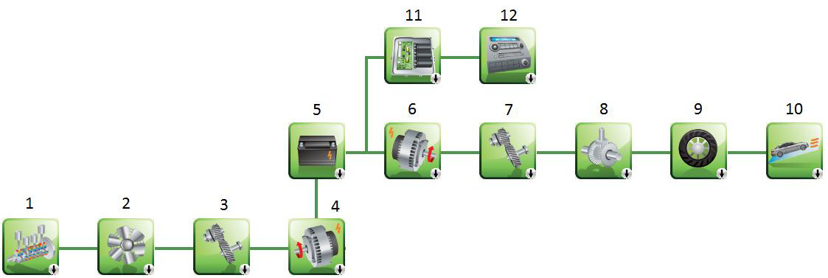
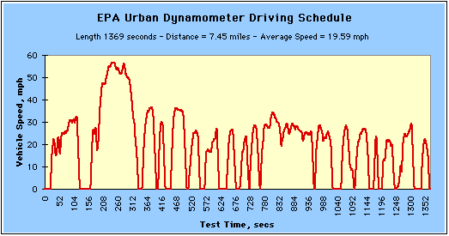
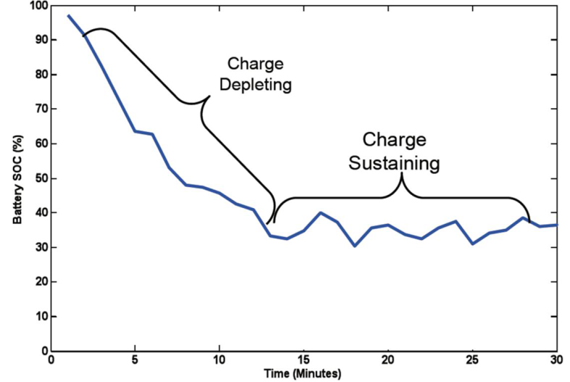
Model-based design
MODEL
DRIVE CYCLE
CONTROL

Slide 45
CAES / Hybrid Vehicle Analogy
MODEL
Modular construction
of Architectures
Peak Shaving
or
Intermittent Energy Buffer
Electricity Grid Demand
Grid Stability
DRIVE CYCLE
CONTROL

Slide 46
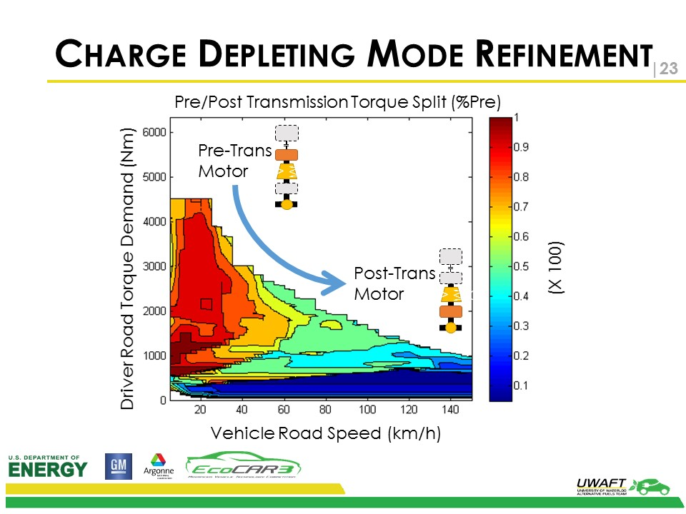

Slide 47
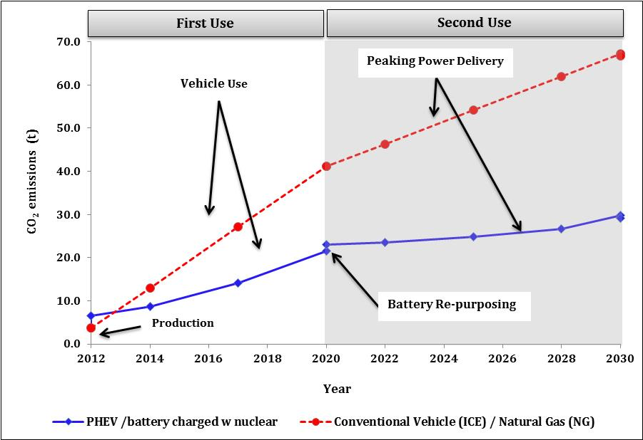
Battery Second Use
Effect on CO2 emissions

Slide 48
CAES Architecture Options
Traditional gas turbine CAES **
Adiabatic CAES **
Isothermal CAES
Caverns at different pressures
Air engines
Direct wind to CAES
Renewables through grid to CAES
Traditional Base load through grid to CAES
Variable cavern injection temperatures
Hybrid Adiabatic / Isothermal CAES
Battery / flywheel etc. hybrid capacitor analogy systems
Fast response by-pass systems
Etc. ** base cases
Empowered by
Model-Based
Design

Slide 49
Electrical Grid Issues
System Studies
Long-term Operations
Short-term Operations
Real-time Operations
Resource Studies
Life-cycle Analysis
Energy Management
System
Electricity Markets
Smart Grids
Reactive Power
Ancillary Service
DOPF
Dynamic Models
Rate of Return Analysis
Pricing
Spinning Reserve
Markets
Techno-economic
Studies
Renewable Energy
Coordination
DG Planning
Sustainable Energy
Technologies
Mathematical Model
with CAES
Grid Impact
Demand Response
CAES Sizing
and Siting
Ontario / Alberta
Issues: Modeling
58
47

Slide 50
Government Policy
Feed-In Tariff to promote Wind and Solar
(no storage allowed)

Slide 51
Government Policy
Feed-In Tariff to promote Wind and Solar
(no storage allowed)
Installing Public Chargers
(elec. utility $; EV like fossil fuel car)

Slide 52
Government Policy
Feed-In Tarrif to promote Wind and Solar
(no storage allowed)
Installing Public Chargers
(elec. utility $; EV like fossil fuel car)
LARGE SCALE ENEGY STORAGE REQUIRED!!

Slide 53
Why CAES?
Government’s commitment to carbon emissions reduction
500 MW for 15 hours has surface footprint of only several hectares.
CAES with air engines zero CO₂ possible.
No significant technical barriers.
Research and IP spinoffs
Grid Benefits (capacity, stabilization, resilience)
Lower Base Load is feasible
Reduced need for Natural Gas

Slide 54
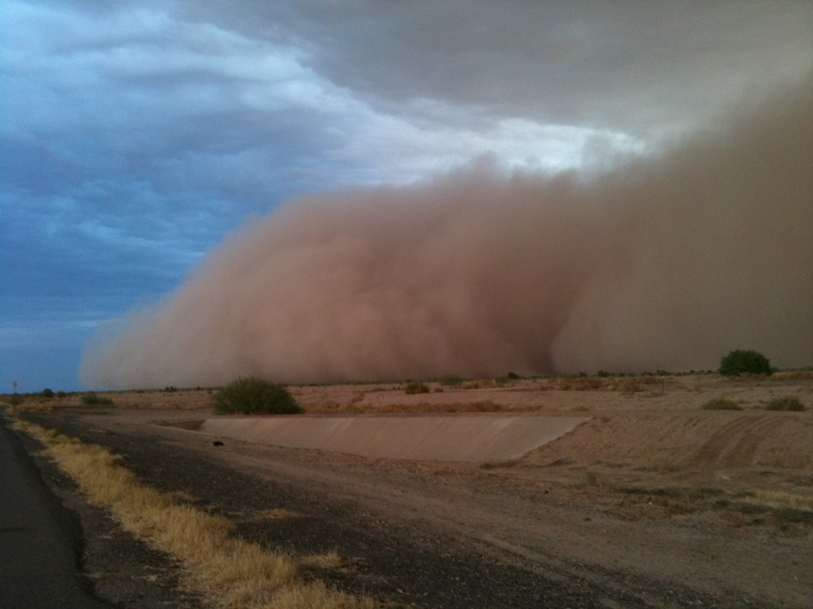
CAES is needed
Questions?

